Slide 1
Lecture 5 Algorithm Performance Analysis
Department of Computer Science
Hofstra University

Slide 2
Lecture Goals
Calculate the big-O class of complicated code snippets.
Define worst case, average case, and best case performance and describe why each of these is used.
State and justify the asymptotic performance for linear search, binary search, selection sort, insertion sort, merge sort, and quick sort.
Recognize and avoid some common pitfalls in asymptotic analysis.
Use Java timing libraries to measure execution time.
Use runtimes from a real system to reason about performance.
Identify components of real systems which impact execution time.

Slide 3




Motivation
Algorithm: a strategy for solving a problem.
Algorithm with good performance can answer very hard questions in very short amount of time. We need to have a sense of how good our algorithm is without just running it.
Performance: how good that strategy is.
There is hereby imposed on the taxable income of every individual (other than a surviving spouse as defined in section 2(a) or the head of a household as defined in section 2(b)) who is not a married individual (as defined in section 7703) a tax determined in accordance with the following table:
How long dose this take?
If you are single, never lost your spouse, and not the head of a household, you pay taxes according to the following table:
Use flesch score to measure of text readability
Problem with just looking at the “stopwatch” time.
different computers
different compilers
different libraries/optimizations
The time for running the specific code on a specific machine on a specific input
Is NOT a good representation of how good our algorithm is.

Slide 4


Performance Analysis Overview
What an algorithm can control?
The number of operations
#1: Count operations instead of time
Is data size all that matters?
Start at first index of array/list
While current index is less than length:
count syllables
#3: Go beyond input size
We'd like our performance analysis to be able to capture not just the size of the input but also what might happen because of internal structure to the input.
large input, more operations
small input, less operations
#2: Focus on how performance scales
Worst, Best, and Average Performance Analysis
If list is twice as long,
how much more time does it take to search it?
Asymptotic Performance Analysis

Slide 5
Count Operations
public static boolean hasLetter(String word, char letter)
{
for (int i = 0; i < word.length(); i++) {
if (word.charAt(i) == letter) {
return true;
}
}
return false;
}
initial step
final check
Linear search
0
1
2
3
4
H
a
p
p
y
Is the number of operations the same every time we run
hasLetter(String word, char letter)?
Search for the letter “a” in the word “Happy”
Search for the letter “x” in the word “Happy”
NO
How many operations get executed?
Each iteration(in the middle of the algorithm) contains 3 operations
hasLetter("happy", ”a"); hasLetter("happy", "x"); hasLetter("apple", "a");
Total operations so far:
1
2
3
4
5
6
7
Total iterations: 5
Total operations: 18

Slide 6
Introduction to Asymptotic Analysis
if (word.charAt(i) == letter) {
return true;
}
What counts as an operation?
Basic unit that doesn’t change as the input changes
input
Constant time
irrelative to the input size
input of size n
We don’t need to worry about anything irrelative to input size
1
int count = 0;
for (int i = 0; i < word.length(); i++) {
count++;
}
1
1
Implementations of specific operations
1
Initialization time
Linear time
n times
1 + (1 + 3n + 1)
3n + 3
relative to the input size
Focus on how performance scale with the increase of input size
Asymptotic Analysis
count
i
n
public static int count_a(String s1, int threshold) {
int total = 0;
for(int i = s1.length() - 100; i < s1.length(); i++) {
char c = s1.charAt(i);
if (c == 'a’)
total++;
}
}
If input is twice as big,
how many more operations do we need?
Assumes string length <= 100
The loop always has 100 iterations
Constant time

Slide 7
Asymptotic Analysis
Asymptotic analysis examines how functions behave as their input grows arbitrarily large. It focuses on the "tail behavior" or limiting behavior of functions rather than their exact values for specific inputs.
runtime as input size n gets large.
rate of growth determined by the dominating highest-order term.
leading coefficient and lower-order terms fell away.
e.g. we don’t care if the algorithm runs for 10 ms vs. 2 s with small input size n; we care if it runs for 100 s vs. 100 hours/days/years for very large n.
Notes:
exact runtime usually not worth the effort asymptotic efficiency

Slide 8
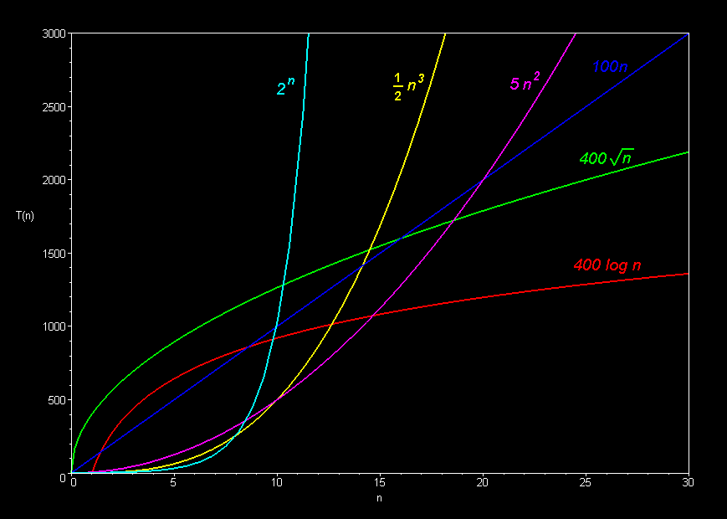
Big-O Classes
The goal is to look at the code and pick up its big-O classes. Don’t worry about the formal definition too much.
f(n) is big-O of g(n) and they grow in same way as their input grows
Linear -- O(n)
Quadratic -- O(n²)
Cubic -- O(n³)
Logarithmic -- O(log n)
Exponential -- O(2^{n})
Square root -- O(sqrt n)
f(n) = O(g(n))
means
there are constants N and c so that for each n > N, f(n) ≤ C g(n)
FORMAL
We use big-O classes as a tool to phrase how algorithm performance scale.
Two functions are in the same big-O class if they have the same rate of growth.
Other notations represent a finer-grained asymptotic analysis, such as lower and upper bound. We focus on big-O for the tightest upper bound.
How to compute big O?
Asymptotic comparison operator Numeric comparison operator
Our algorithm is o( something ) A number is < something
Our algorithm is O( something ) A number is ≤ something
Our algorithm is Θ( something ) A number is = something
Our algorithm is Ω( something ) A number is ≥ something
Our algorithm is ω( something ) A number is > something
Drop constants
Example: initialization cost, whose number of steps doesn’t change with input size n
10000000 = O(1)
Keep only dominant term
Fastest growing
Big-O notation in 5 minutes
https://www.youtube.com/watch?v=__vX2sjlpXU
3n+3 = O(3n) = O(n)

Slide 9
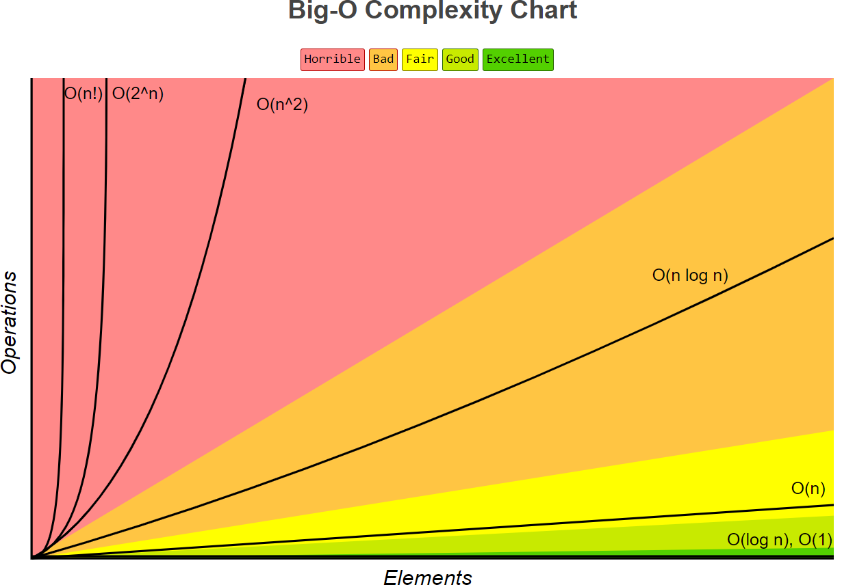
Big-O Complexity Chart
O(1) < O(logn) < O(n) < O(nlogn) < O(n²) < O(2") < O(n!)
https://www.bigocheatsheet.com/

Slide 10
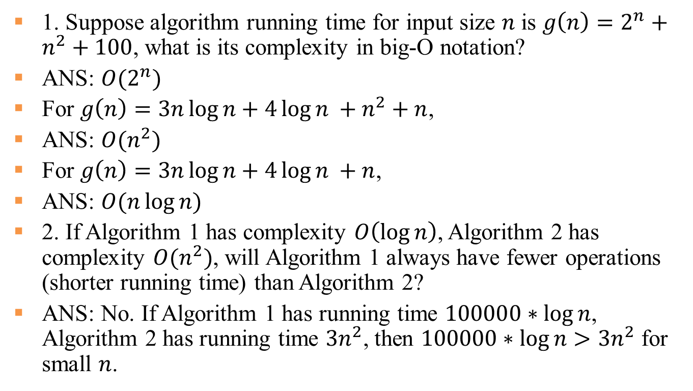
Quiz
1. Suppose algorithm running time for input size $n$ is $g\left(n\right)=2^{n}+n^{2}+100$, what is its complexity in big-O notation?
ANS: $O(2^{n})$
For $g\left(n\right)=3n\log{n}+4\log{n} +n^{2}+n$,
ANS: $O(n^{2})$
For $g\left(n\right)=3n\log{n}+4\log{n} +n$,
ANS: $O(n\log{n})$
2. If Algorithm 1 has complexity $O\left(\log{n}\right)$, Algorithm 2 has complexity $O(n^{2})$, will Algorithm 1 always have fewer operations (shorter running time) than Algorithm 2?
ANS: No. If Algorithm 1 has running time $100000∗\log{n}$, Algorithm 2 has running time $3n^{2}$, then $100000∗\log{n}>3n^{2}$ for small $n$.

Slide 11
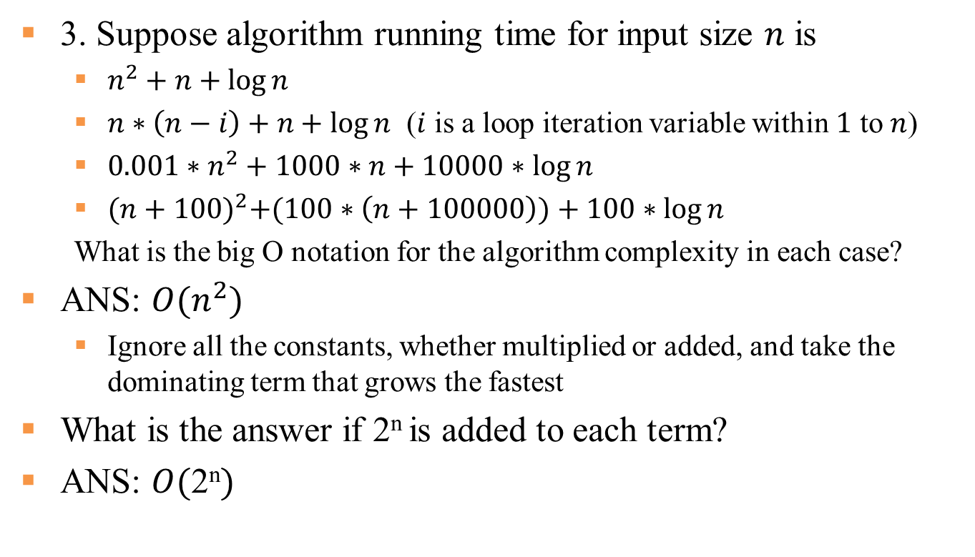
Quiz Con’t
3. Suppose algorithm running time for input size $n$ is
$n^{2}+n+\log{n}$
$n∗\left(n−i\right)+n+\log{n}$ ($i$ is a loop iteration variable within $1$ to $n$)
${0.001∗n}^{2}+1000∗n+10000∗\log{n}$
${(n+100)}^{2}+(100∗\left(n+100000\right))+100∗\log{n}$
What is the big O notation for the algorithm complexity in each case?
ANS: ${O(n}^{2})$
Ignore all the constants, whether multiplied or added, and take the dominating term that grows the fastest
What is the answer if 2^{n} is added to each term?
ANS: $O(\text{2}\text{n})$

Slide 12
Compute Big O for Consecutive Code
public static void reduce (int[] vals) {
int minIndex =0;
for (int i=0; i < vals.length; i++) {
if (vals[i] < vals[minIndex]){
minIndex = i;
}}
int minVal = vals[minIndex];
for (int i=0; i < vals.length; i++){
vals[i] = vals[i] - minVal;
}
}
[1,2,5,3]
-> [0,1,4,2]
O(1)
+
The first for loop finds the minimum value of the array. The second for loop reduces each value in the array by the minimum value.
O(n)
+
Run times are independent
These doesn’t depend on the input size(n)
How the operations depend on the size of the input?
There will be n loop iterations
Each iteration will take constant time
O(1)
+
O(n)
+
1 + n + 1 + n = 2n + 2 = 2n + 2
Total: O(n)
Linear Algorithm

Slide 13
Compute Big O with Nested Operations
[1,7,2,4,6,8]
-> 7
public static int maxDifference (int[] vals) {
int max = 0;
for (int i=0; i < vals.length; i++) {
for (int j=0; j < vals.length; j++) {
if (vals[i] – vals[j] > max) {
max = vals[i] – vals[j];
}
}
}
return max;
}
O(1)
+
The nested for loops look for the maximum difference between any two array elements. This biggest difference will be between 1 and 8.
Run times are independent
These doesn’t depend on the input size(n)
How the operations depend on the size of the input?
Count from inside out
There will be n inner loop iterations and each takes constant time
There will be n outer loop iterations and each takes linear time O(n)
O(1)
O(n)
x
Multiplication
O(1)
+
O(n²)
+
1 + n² + 1 = n² + 2
Total: O(n²)
Quadratic Algorithm

Slide 14
Short Videos of Sorting Algorithms
Sort Algos // Michael Sambol Michael Sambol
https://www.youtube.com/playlist?list=PL9xmBV_5YoZOZSbGAXAPIq1BeUf4j20pl
Merge Sort, Quick Sort, Bubble Sort, Insertion Sort, Selection Sort, Heap Sort
10 Sorting Algorithms Easily Explained
https://www.youtube.com/watch?v=rbbTd-gkajw
Bubble Sort, Selection Sort, Insertion Sort, Merge Sort, Quick Sort, Heap Sort, Counting Sort, Shell Sort, Tim Sort, Radix Sort
Notes:
https://www.youtube.com/watch?v=JU767SDMDvA
Insertion sort

Slide 15
Practice: Analyze Big-O Class of Selection Sort
The idea is to find the smallest value in the remaining unsorted array and put that at the start. And then just keep repeating that process over and over.
n
+ (n-1)
+ (n-2)
+ … + 1
(Gauss sum)
O(n-i)*O(n)?
NO
public static void selectionSort(int[] vals) {
int indexMin;
for(int i = 0; i < vals.length-1; i++) {
indexMin = i;
for(int j = i + 1; j < vals.length; j++) {
if(vals[j] < vals[indexMin]) {
indexMin = j ;
}
}
swap (vals, indexMin , i);
}
}
4
7
2
10
1
8
O(1)
outer loop runs n times
nested loop
unsorted
1
7
2
10
4
8
O(1)
sorted
unsorted
1
2
7
10
4
8
sorted
unsorted
1
2
4
10
7
8
inner loop runs n - (i+1) times
O(1)
O(n-i)
O(1)
O(n-i)
1
2
4
7
10
8
O(n²)
1
2
4
7
8
10
Total: O(n²)
temp = vals[indexMin];
vals[indexMin] = vals[i];
vals[i] = temp;
To swap:

Slide 16
Best case, Average case, Worst case
How does the algorithm behave for all inputs?
when will the largest amount of operations be executed?
Input
Algorithm
Output
(same input size)
hasLetter("apple", "a");
public static boolean hasLetter(String word, char letter)
{
for (int i = 0; i < word.length(); i++) {
if (word.charAt(i) == letter) {
return true;
}
}
return false;
}
Best case: word starts with letter O(1)
just 1 loop iteration
special case
input
hasLetter("happy", "x");
when is the least number of operations be executed?
output
hasLetter("happy", ”y");
- algorithm performance depends on the combination of both inputs
Worst case : letter at the end (or missing) O(n)
How can we account for this variability?
- n loop iterations
(lower bound)
sandbox
(upper bound)
(realistic,but too hard)
≤
Best case
Worst case
Average case
Best possible performance of algorithm for any input (of fixed size n)
Worst possible performance of algorithm for any input (of fixed size n)
Performance of algorithm on average, consider all possible inputs of size n

Slide 17
Analyze Search Algorithms
 | Best Case | Worst Case
Linear Search
Binary Search*
# times to half size?
O(1)
O(n)
How many times can we divide by 2 before we get to 1?
O(1)
O(log(n))
* Assuming data is sorted
sorting cost?
Binary Search: Basic Algorithm
Initialize low = 0, high = length of list
while low <= high:
mid = (high+low)/2
if toFind matches value at mid,
return true
if toFind < value at mid
high = mid-1
else low = mid+1
return false
Cuts search base in half at each iteration, so the total # iterations is log₂(n)
Linear Search: Basic Algorithm
Start at the first index in the array
while index < length of the array: if toFind matches current value,
return true
increment index by 1
return false
first half
second half
E.g. hasLetter(String word, char letter)
Worst case: don't find!
Binary search in 4 minutes
https://www.youtube.com/watch?v=fDKIpRe8GW4
log₁₀(n) = O( log₂(n) )
since:

Slide 18
Analyze Sorting Algorithms
public static void insertionSort(int[] vals) {
int currInd;
for(int pos=1; pos < vals.length; pos++) {
currInd = pos ;
while (currInd > 0 &&
vals[currInd] < vals[currInd-1]) {
swap(vals, currInd, currInd-1);
currInd = currInd – 1;
}
}
}
 | Best Case | Worst Case
Selection Sort
Insertion Sort
O(n²)
O(n²)
O(n)
O(n²)*
when already sorted
when in reverse order
1
2
3
4
5
6
6
5
4
3
2
1
* similar to selection sort analysis
- # of loop iterations depends on the values of the pairs of consecutive elements
Selection Sort: Basic Algorithm
For each position i from 0 to length-2
Find smallest element in positions i to length-1
Swap it with element in position i
Insertion Sort: Basic Algorithm
For each position i from 1 to length-1
Swap successive pairs to put value in position i in correct location relative to earlier values
which next?
1
8
4
3
7
2
pos 1
1
4
8
3
7
2
pos 2
sorted
i
unsorted
1
3
4
8
7
2
pos 3
sorted
i
unsorted
Best, average, worst?
1
3
4
7
8
2
pos 4
1
2
3
4
7
8
pos 4

Slide 19
Analyze Merge Sort
Merge Sort: Basic Algorithm
If list has one element, return.
Divide list in half
Sort first half Sort second half
Merge sorted lists
5
3
2
4
1
5
3
2
4
1
5
3
2
4
1
Keep dividing by two until lists have size 1
log₂(n)
3
5
2
4
1
3
5
2
1
4
Each time we divide, we call MergeSort on two (smaller) lists
3
5
1
2
4
*Asymptotics is not the only measure of performance
HOW?
Divide and conquer. Recursion!
1
2
3
4
5
O(n) work to merge all the lists on one level
A Summary of Sorting
 | Best | Average | Worst
Selection Sort | O(n²) | O(n²) | O(n²)
Insertion Sort | O(n) | O(n²) | O(n²)
Merge Sort | O(nlog(n)) | O(nlog(n)) | O(nlog(n))
*Quick Sort | O(nlog(n)) | O(nlog(n)) | O(n²)
compare the head of each list
Performance?
O(nlog(n))

Slide 20
Common Pitfalls in Asymptotic Analysis
O(1)
grow faster
public static boolean hasLetter(String word, char letter)
{
for (int i = 0; i < word.length(); i++) {
if (word.charAt(i) == letter) {
return true;
}
}
return false;
}
<
O(log n)
Base of logarithm doesn’t matter
<
O(n)
<
O(n²)
<
O(2^{n})
Algorithm 1
Algorithm 2
Beware of method calls
O(log n)
O(n²)
what input will I be working with?
Algorithm & Data structure Design
Will Algorithm 1 always use fewer operations than Algorithm 2?
No. 100000*log n > 1*n^{^2} if n=10
Performance Analysis
Notes:
What's an operation?

Slide 21





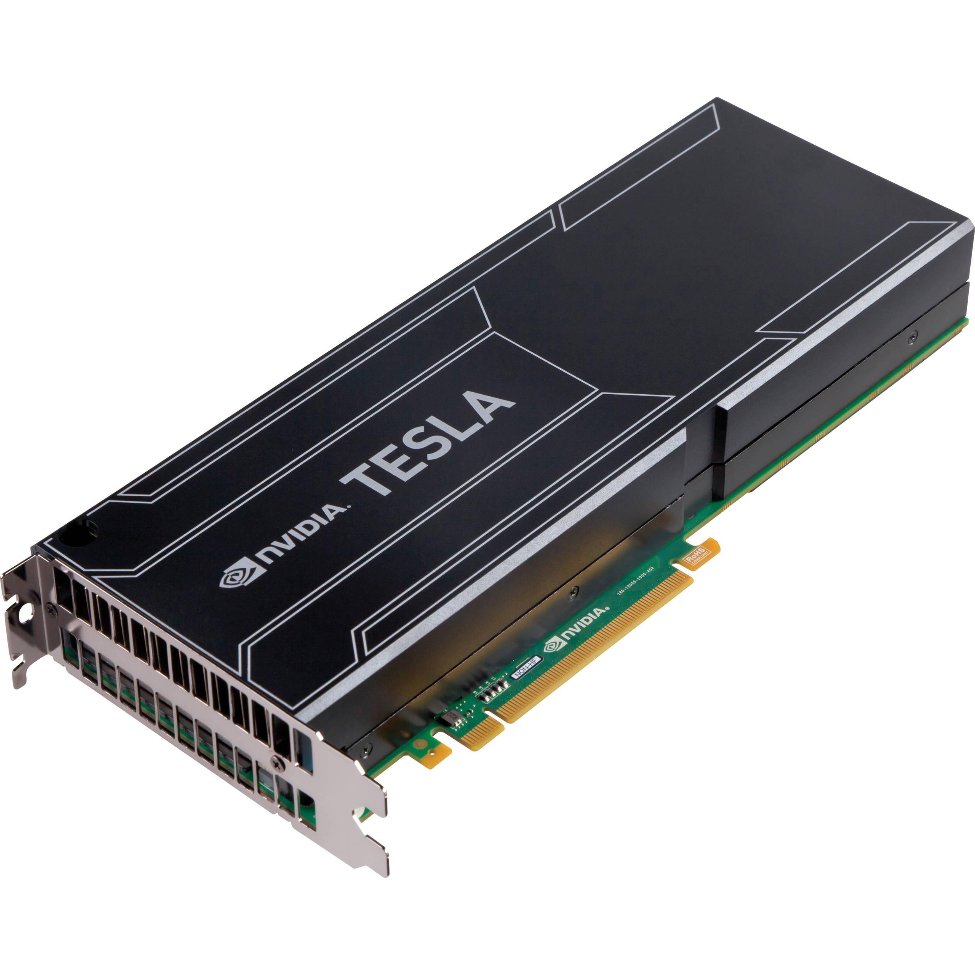

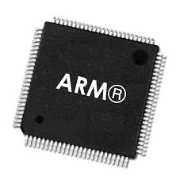
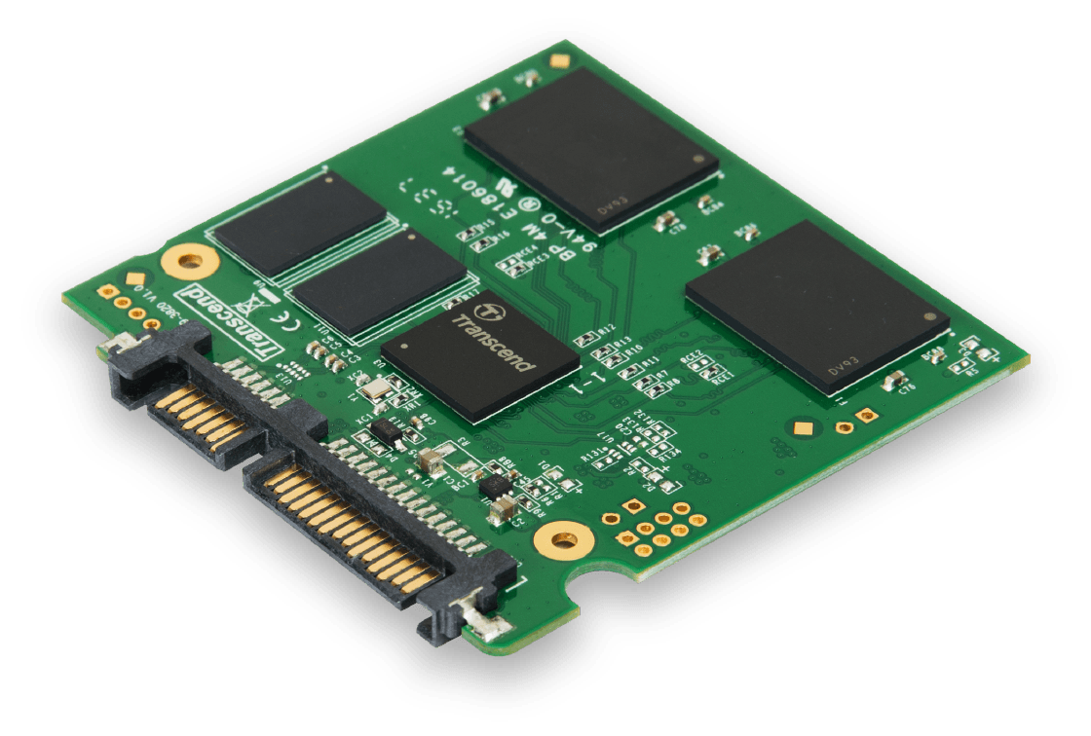


Introduction to Benchmarking
Your Java Code Version A
Your Java Code Version B
Times might not be consistent…
The running time of a program is influenced by many things!
www.speedtest.net
~10 seconds
~5 seconds
bytecode
abstraction
Your Java Code
Java Compiler
Java Virtual Machine
abstraction for hardware resource
Makes choices that affect performance
Operating System
So how do we reason about how long it takes for a program to run on real systems? Couldn’t we just time how long our programs take?
These systems are MEANT to be hidden from you
Hardware
YES!

Slide 22
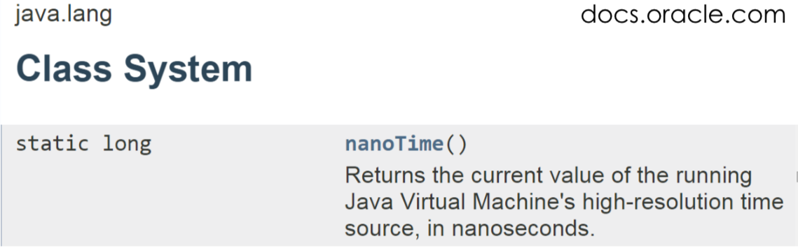
Details of Benchmarking (Using Java Timing API)
Just means running programs on real machines and measuring performance
For us, “performance” is just how long it takes for something to execute.
Allows us to compare machines by running the same program
Allows us to compare programs on a single machine
Same program
public static void main(String [] args) {
// set some size n
double array[] = new double[n];
// fill the array with contents (random)
long startTime = System.nanoTime();
selectionSort(array);
long endTime = System.nanoTime();
double estTime = (endTime-startTime) /
1000000000.0;
System.out.println(estTime);
}
vs.
Same machine
Program B
Program A
vs.
We’ll do this, next!
we just want this time
How long does selection sort run?

Slide 23
Idea for Analyzing Our Sorts
For increasing sizes of n
Print n
Create a randomized array of size n
Time selection sort, print outcome
Create a randomized array of size n
Time quick sort, print outcome
n Selection (s)
10000 0.112887621
20000 0.397227565
30000 0.580318935
40000 1.020979179
50000 1.605557659
60000 2.340087449
70000 3.264979954
80000 4.097073897
90000 5.285101776
100000 6.57904119
Quick (s)
0.001323534
0.001568662
0.002420492
0.003304295
0.004232703
0.004983088
0.006035047
0.006989112
0.007900941
0.008538038
By “best fit” I just found a good value for constant “k”
Won’t all “best fits” look really good?
Quicksort is fantastic
n² is best, matching our high-level analysis
Select: Looks like n² growth

Slide 24
Idea for Analyzing Our Sorts (Contd.)
Zoom in on quick sort
Real data…
- input
- system task
n | log₂n
10,000,000 | ?
Looks linear?
We can use real runtimes to reason about performance
Be prepared for real system data to be noisy
Can be really useful when we want to understand actual performance on a real system
~23
best fit analysis
Get more data…
Still appears linear
log(n) is just really small relative to n

Slide 25
Additional Resources
Big-O analysis
http://web.mit.edu/16.070/www/lecture/big_o.pdf -- Big O handout from MIT
https://www.interviewcake.com/article/java/big-o-notation-time-and-space-complexity -- explanation of Big O with examples
http://discrete.gr/complexity/ -- "A Gentle Introduction to Algorithm Complexity Analysis" GIves a lot more detail than what we provided.
Sorting algorithms
http://www.java2novice.com/java-sorting-algorithms/ -- 5 different sort algorithm explanation with codes
https://www.cs.cmu.edu/~adamchik/15-121/lectures/Sorting%20Algorithms/sorting.html -- different search algrotihms with solid examples
Timing code in Java
http://stackoverflow.com/questions/180158/how-do-i-time-a-methods-execution-in-java -- many ways offered by many people

